Slide 1



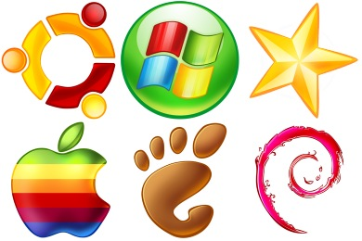
OS Architectures
OS Architecture, Kernel, Drivers, Processes, Multitasking, Users, Networking, Virtualization
Svetlin Nakov
Technical Trainer
www.nakov.com
Telerik Software Academy
academy.telerik.com

Slide 2

Table of Contents
…

Slide 3
…
…

Slide 6
…
…

Slide 9
…
…

Slide 12
…
…

Slide 15
…
…

Slide 18
…
…

Slide 21
…
…

Slide 24
OS Architectures
http://academy.telerik.com/student-courses/software-technologies/os-windows-linux/

Slide 25
Exercises
…
…
…

Slide 26
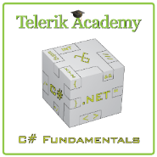



Free Trainings @ Telerik Academy
C# Programming @ Telerik Academy
csharpfundamentals.telerik.com
Telerik Software Academy
academy.telerik.com
Telerik Academy @ Facebook
facebook.com/TelerikAcademy
Telerik Software Academy Forums
forums.academy.telerik.com

